Slide 1

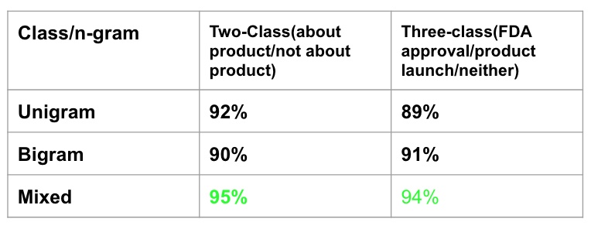
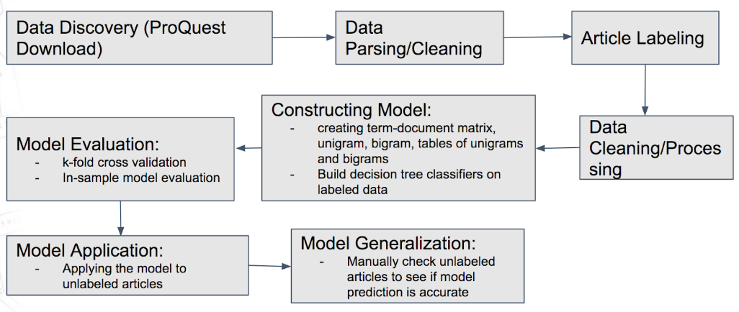
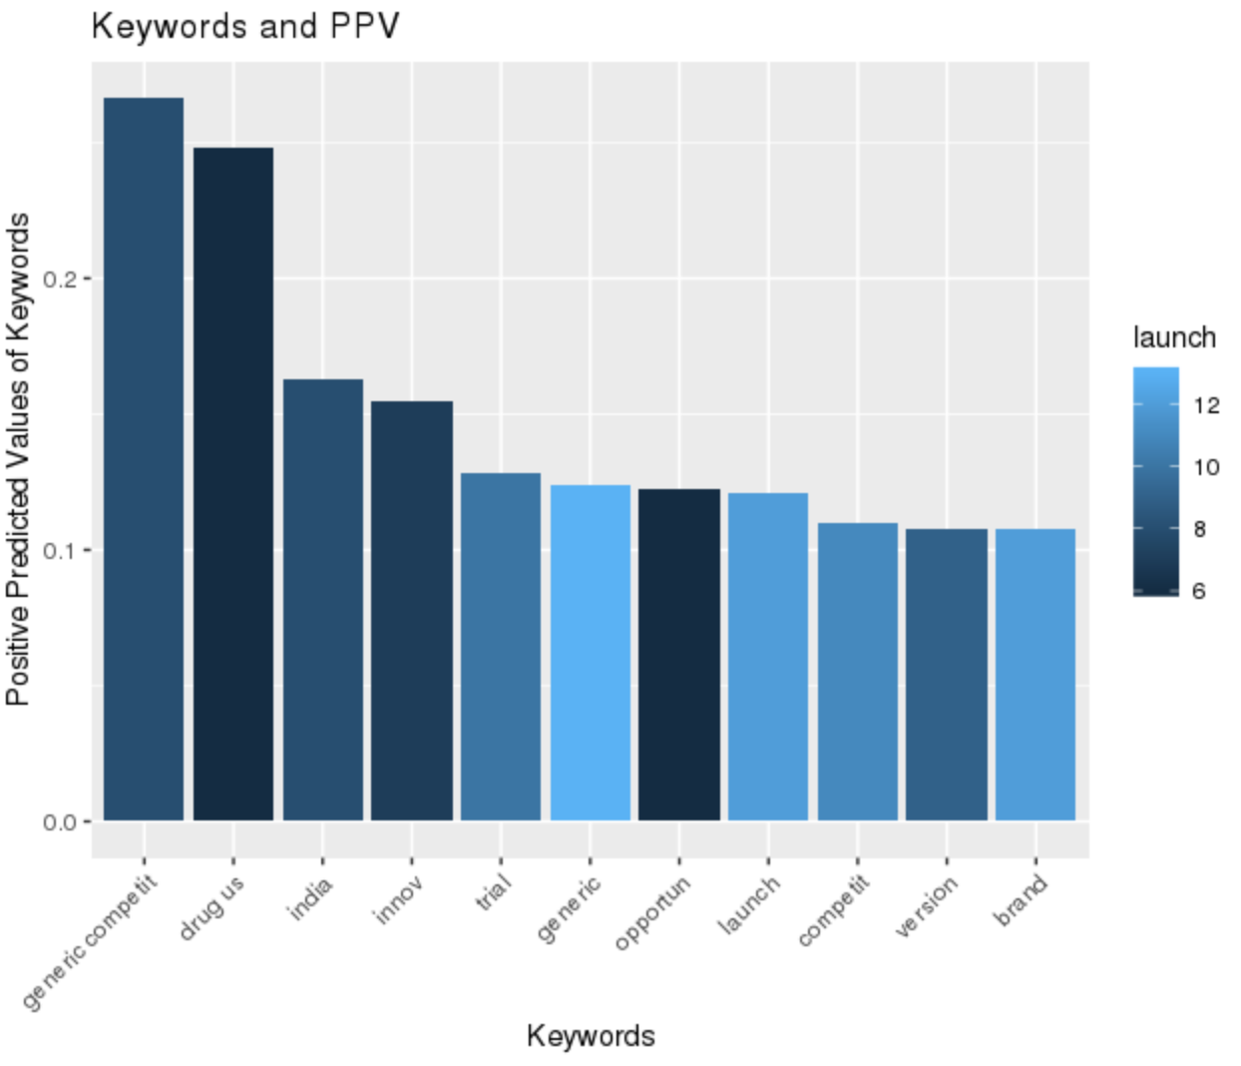
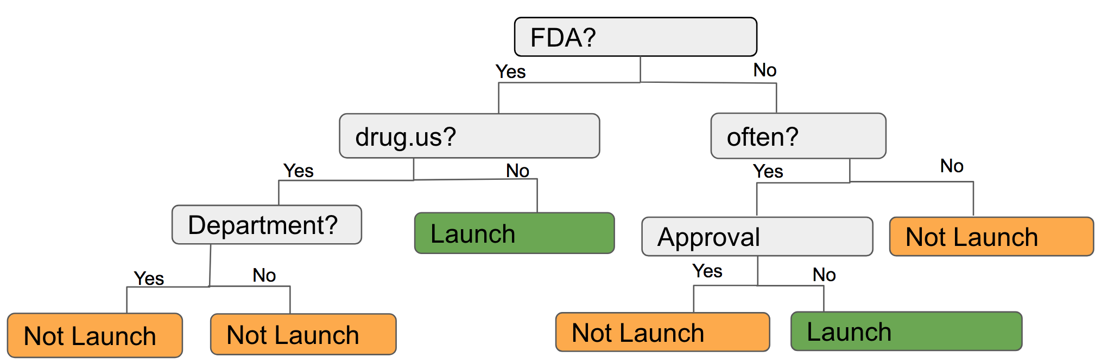
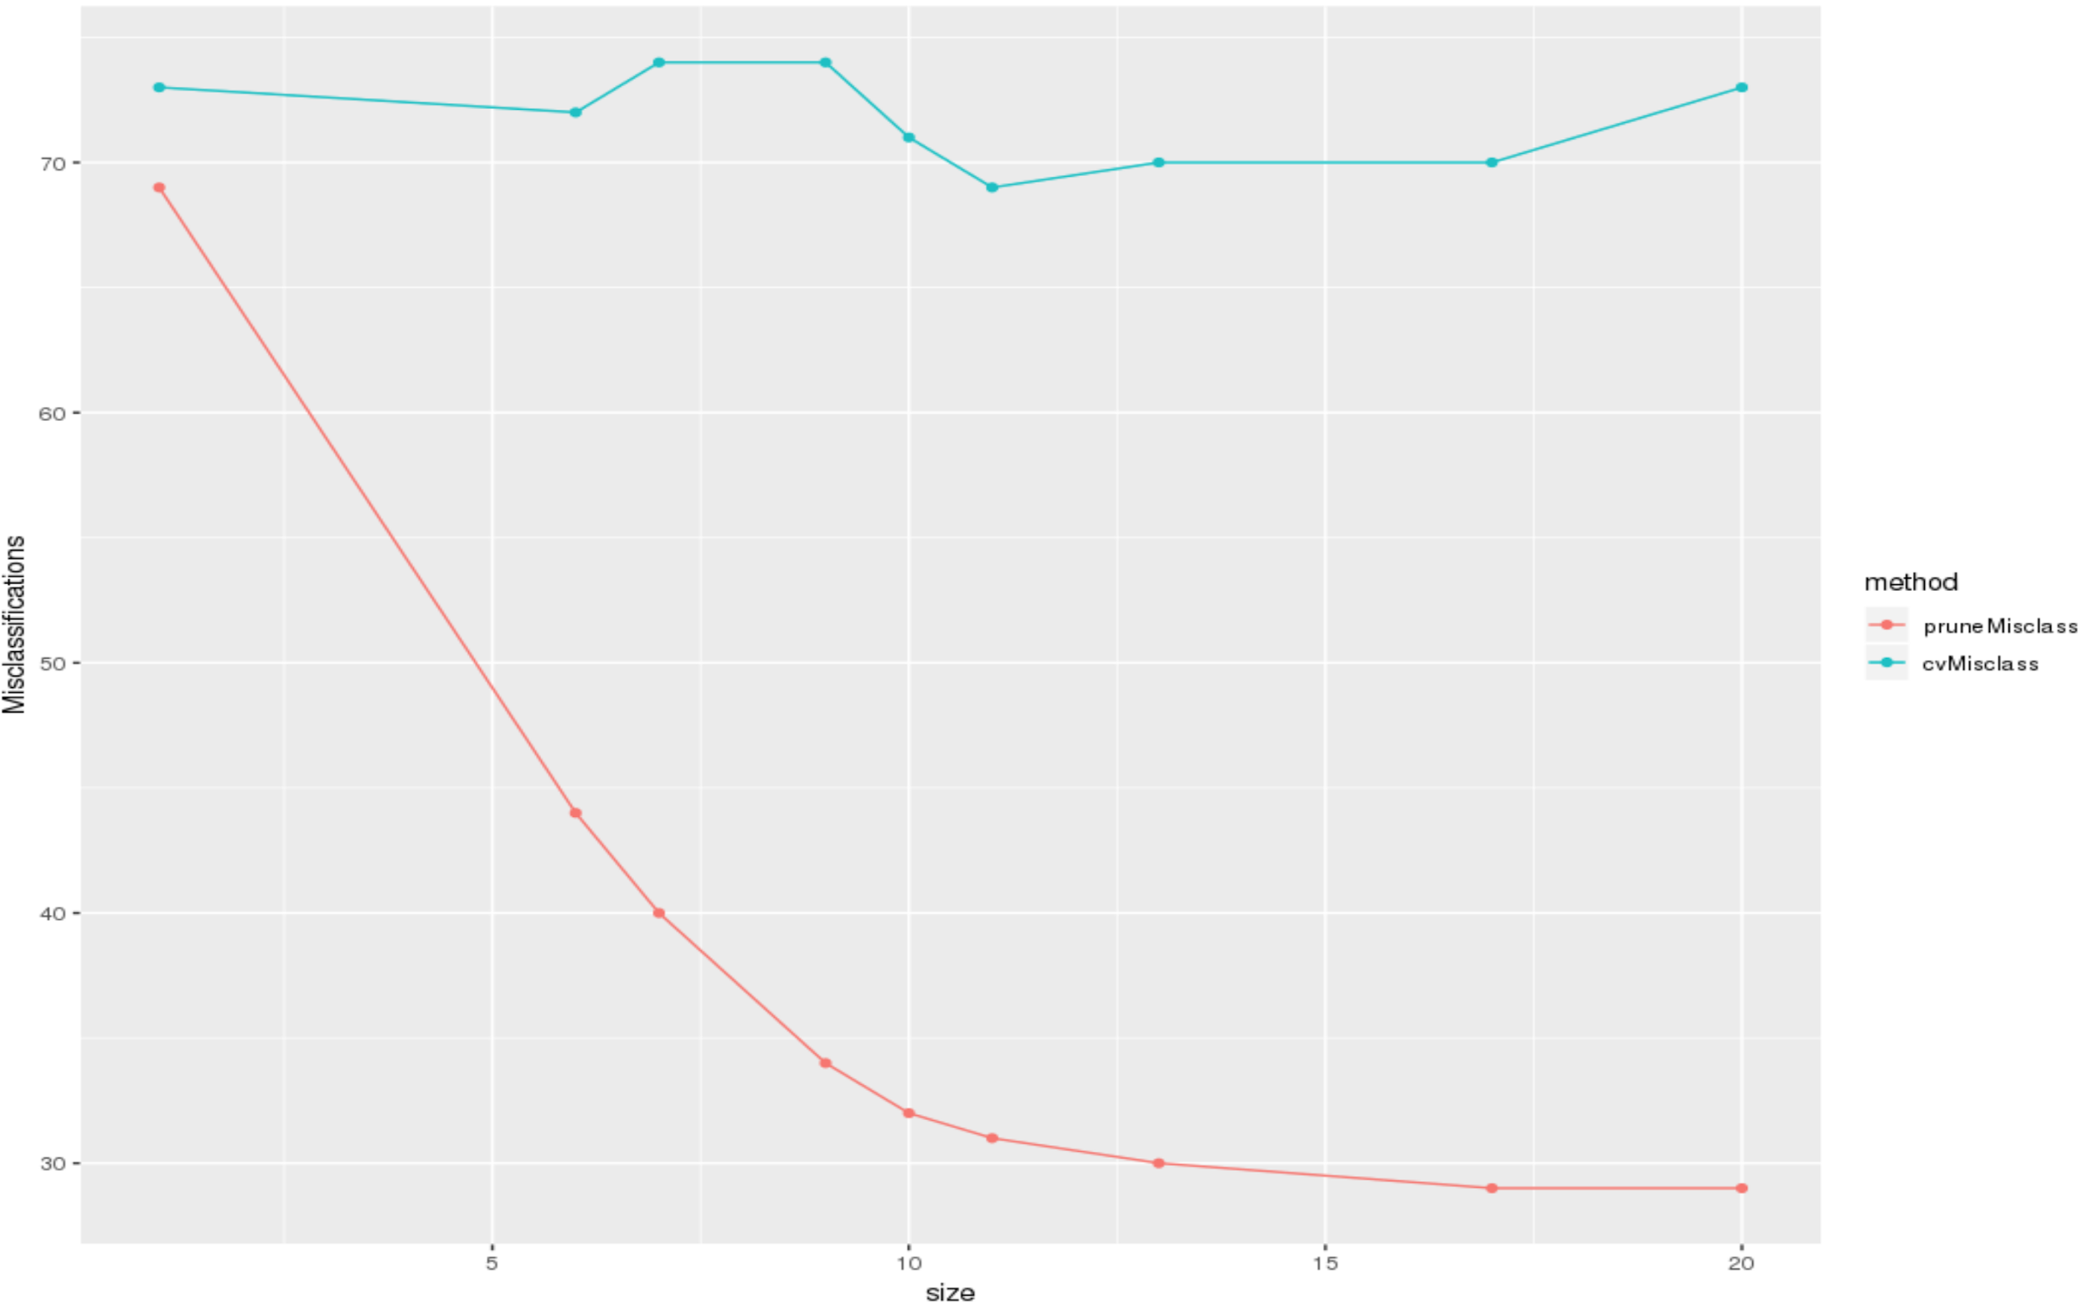

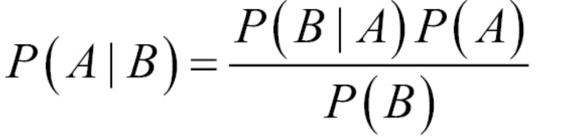
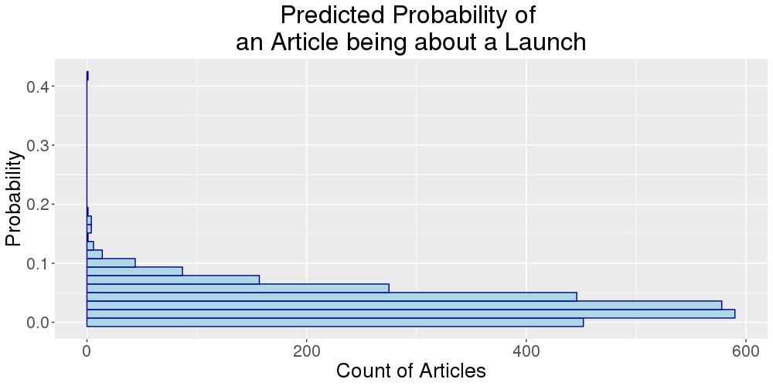
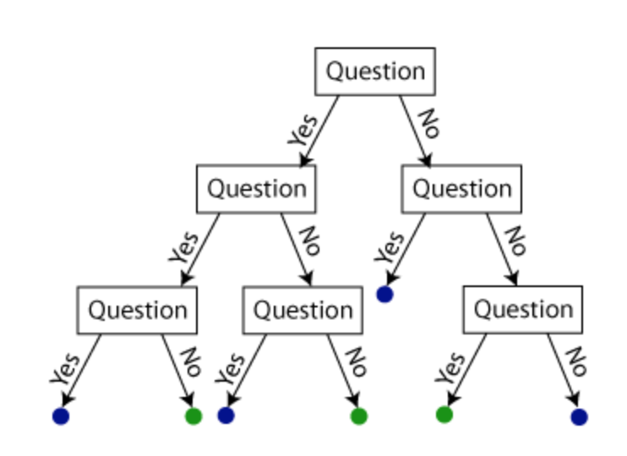

Identifying and Predicting Product Launch Articles
with Machine Learning Algorithms
Fangfang Lee (NYU), Raghav Sawhney (VT), Eirik Iversen (VT), Luke Kim (VT)
SDAL: Ian Crandell, Gizem Korkmaz, and Stephanie Shipp
Sponsor: Gary Anderson, The National Center for Science & Engineering Statistics (NCSES) at the National Science Foundation
Introduction
Model Construction
Product innovation is traditionally measured through surveys of selected companies. NCSES is interested in exploring the possibility of using non-traditional data sources to measure product innovation in lieu of surveys.
This project assesses the feasibility of detecting news articles that are about product launches using an automated machine learning model.
Specifically, we test out whether machine learning algorithms can automate the process of predicting whether an article is about product innovation.
Data transformation
  The articles collected from ProQuest are turned into term-document matrices--where each column is a word and each row is a document.
  From each article we also extract unigrams (individual words) and bigrams (pairs of consecutive words).
  The unigrams and bigrams are then filtered:
    Unigrams must show up in at least 40 documents
    Bigrams must show up in at least 5 documents
  We also perform the following cleaning procedures:
    Stemming
    White-space removal
    Three class + unigram
    Three class + Bigram
    Three class + mixed grams
We examined a total of six models for classification:
    Two class + Unigram
    Two class + Bigrams
    Two Class + Mixed grams
Two class classification--is this article about a product launch or not?
Three class classification--is this article about an FDA approval, a product launch, or neither?
Cleaned unigrams, bigrams, and mixed grams serve as predictors in the modeling process.
    Punctuation removal
    Stop words removal
Data and Methods
Model Performance and Evaluation
We collected our data from ProQuest, a publication aggregator. It is an excellent asset for collecting information on business innovation because it compiles a wide variety of articles in all sectors, which includes comprehensive news articles on product announcement and FDA approval.
Dictionary Approach Model Overview
  We used Bayes Theorem to calculate the positive predicted value of a given word
  We have found a series of words that are likely to be predictive of whether an article is about a launch:
    The words chosen above are determined by both PPV and discretion of the researchers.
  We will filter the unlabeled articles by how many times these distinct words have showed up and validate our models.
Tree Modeling Performance Overview
  Accuracy rate: total number of correct prediction/total
Prediction.
Decision Tree Diagram (Best performing tree--two class with mixed grams)
Cross Validation & In-Sample misclassification rate
                X axis represents tree dept, Y axis represents numbers of misclassified cases
                As tree grows deeper, number of in-sample misclassification rate (orange) always decreases due to overfitting
                Number of cross-validated misclass rates (blue) is lowest at 11.
The “Dictionary Approach”:
  Without using any machine learning model, can we manually pick out the words or phrases that predict a product launch article?
  Given the appearance of a word, what is the probability of the article being about a product launch?
  Using manually labeled articles, the conditional probability, or positive predictive value (PPV) of an article being a launch can be calculated with Bayes Theorem:
  We can then use the PPV to predict which articles are most likely to be launch based on the words.
  Can we compare this naive approach to the machine learning models?
Classification and Regression Tree (CART) [1]:
  Decision trees stratify or segment the predictor space into a number of sub regions.
  A decision tree is a flowchart-like structure in which each internal node represents a "test" on an attribute (e.g. whether a coin flip comes up heads or tails).
  Each branch represents the outcome of the test.
  Each leaf node represents a class label
  The paths from root to leaf represent
classification rules.
Random Forest (RF):
  Random forest is an ensemble algorithm that aggregates a series of decision trees.
  RF lowers the variances in predictions that decision trees otherwise have.
Tree Depth
Model Validation and Application
Dictionary Approach
  Applying the dictionary to 2880 unlabeled articles, we have obtained the following table:
  However, after students manually validated the articles with the highest keywords appearance (8 and 7 times), we found out that those articles aren’t about a product launch.
  This is due to the structure of the data:
    PPV of the keywords is low, even for “generic competit”, a 0.22 indicates that given it appears, there is a 22% the article is about launch.
    We cannot aggregate the PPV of multiple words because we cannot assume their appearances are independent.
Decision Tree & Random Forest
  We assembled our previously trained decision trees and used random forest to compute the predicted probability of an article being about a launch.
  The diagram shows the distribution of the probability of unlabeled articles being about product launch.
  After manually validating the article with the highest probability, we found out that it is indeed about launch.
  The machine learning models performed better and more reliably.
Number of keywords showing up in an article | 0 | 1 | 2 | 3 | 4 | 5 | 6 | 7 | 8
Number of unlabeled articles | 629 | 822 | 500 | 232 | 111 | 56 | 14 | 3 | 1
References
Challenge and Next Steps
[1] James, G., Witten, D., Hastie, T., & Tibshirani, R. (2013). An introduction to statistical learning (Vol. 112). New York: springer.
Tree graphics: https://shapeofdata.wordpress.com/2013/07/09/random-forests/
Challenges
  Lack of training Data
    Out of 3600 articles downloaded, only 484 are manually labeled.
  Imbalance of training data
    Out of the 484 labeled data, only 21 are about product launch. The imbalance in true positives makes it difficult for the model to detect signal from noise.
    Without proper domain knowledge, the ability to manually select important keywords is difficult.
  Tree and forests performed well, but the results aren’t necessarily generalizable.
Next steps
  Label more articles.
  Improve the quality of the labeling.
  Improve domain expertise and repeat the iterative process of finding keywords.
  Validate more unlabeled articles to check for the optimal threshold of the dictionary approach.
  Validate using new data sources, e.g., Factiva.
Notes:
Tree pic credit: https://shapeofdata.wordpress.com/2013/07/09/random-forests/
Put one tree. Manual cleaning and beautifies the tree.
Proquest information. Data source.

